Slide 1

COMPUTER NETWORKS
Sivaraman Eswaran Ph.D.
Department of Computer Science and Engineering

Slide 2

COMPUTER NETWORKS
Application Layer
Sivaraman Eswaran Ph.D.
Department of Computer Science and Engineering

Slide 3
COMPUTER NETWORKS
Unit – 2 Application Layer
2.1 Principles of Network Applications
2.2 Web, HTTP and HTTPS
2.3 The Domain Name System
2.4 P2P Applications
2.5 Socket Programming with TCP & UDP
2.6 Other Application Layer Protocols

Slide 4
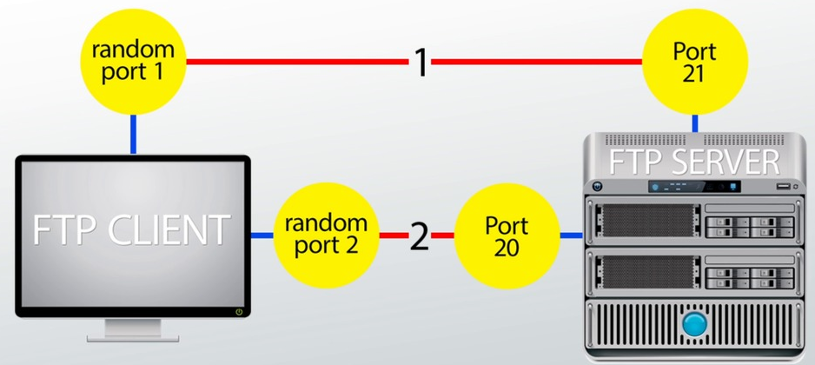
COMPUTER NETWORKS
Other Application Layer Protocols - FTP
File Transfer Protocol (FTP) - used to exchange large files on the internet TCP
Invoked from the command prompt or some GUI.
Allows to update (delete, rename, move, and copy) files at a server.
Data connection (Port No. 20) & Control connection (Port No. 21)

Slide 5
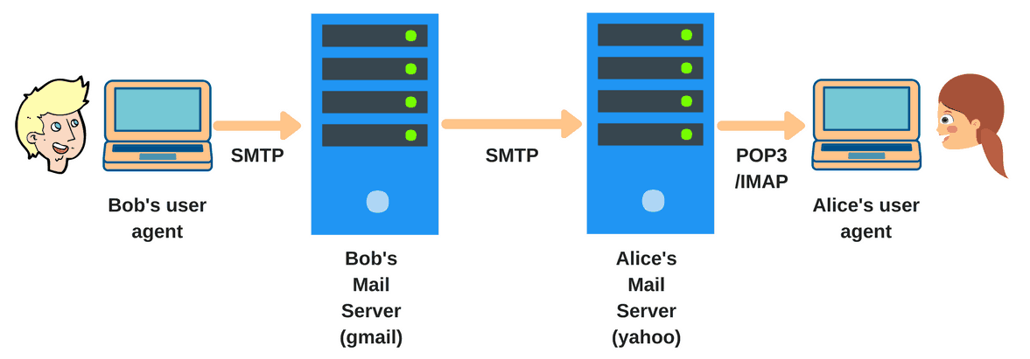
COMPUTER NETWORKS
Other Application Layer Protocols - SMTP
Simple Mail Transfer Protocol - an internet standard for e-mail Transmission.
Connections are secured with SSL (Secure Socket Layer).
Messages are stored and then forwarded to the destination (relay).
SMTP uses a port number 25 of TCP.

Slide 6
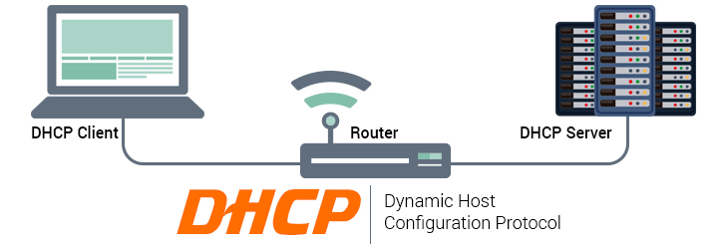
COMPUTER NETWORKS
Other Application Layer Protocols - DHCP
Dynamic Host Configuration Protocol - assign IP addresses to computers in a network dynamically.
IP addresses may change even when computer is in network (DHCP leases).
DHCP port number for server is 67 and for the client is 68.
A client-server model & based on discovery, offer, request, and ACK.
Includes subnet mask, DNS server address, default gateway

Slide 7
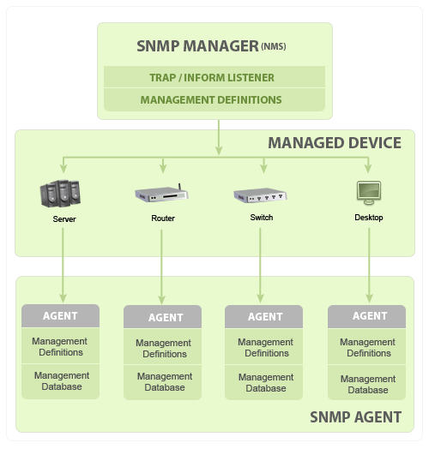
COMPUTER NETWORKS
Other Application Layer Protocols - SNMP
Simple Network Management Protocol - exchange management information between network devices.
Basic components & functionalities
SNMP Manager
Managed Devices
SNMP Agents
MIB (Management Information Base)

Slide 8
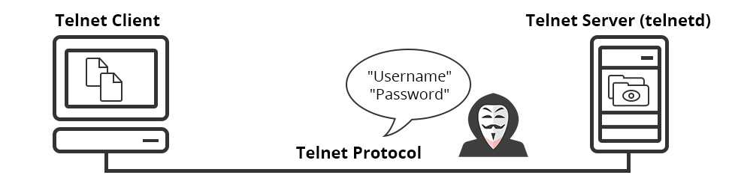
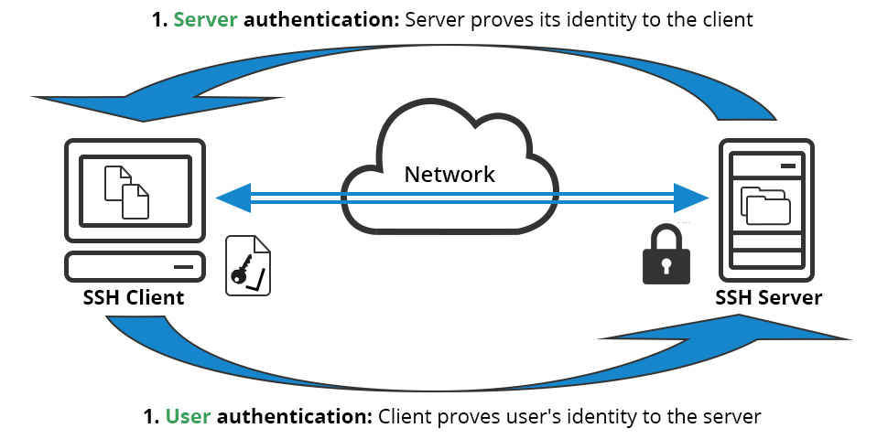
COMPUTER NETWORKS
Other Application Layer Protocols – Telnet & SSH
Allows a user to communicate with a remote device.
Used mostly by network admin to remotely access and manage devices.
Telnet client and server installed – uses TCP port no. 23
SSH – uses public key encryption & TCP port 22 by default.

Slide 9
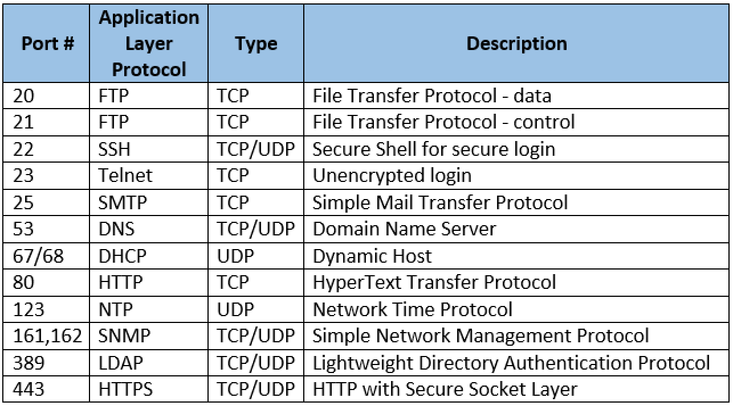
COMPUTER NETWORKS
Summary of Application Layer Protocols

Slide 10
COMPUTER NETWORKS
Summary
our study of network application layer is now complete!
application architectures
client-server
P2P
application service requirements:
reliability, bandwidth, delay
Internet transport service model
connection-oriented, reliable: TCP
unreliable, datagrams: UDP
specific protocols:
HTTP
DNS
P2P: BitTorrent
socket programming:
TCP, UDP sockets

Slide 11
COMPUTER NETWORKS
Summary (more)
Most importantly: learned about protocols!
typical request/reply message exchange:
client requests info or service
server responds with data, status code
message formats:
headers: fields giving info about data
data: info(payload) being communicated
important themes:
centralized vs. decentralized
stateless vs. stateful
scalability
reliable vs. unreliable message transfer
“complexity at network edge”

Slide 12
THANK YOU
Sivaraman Eswaran Ph.D.
Department of Computer Science and Engineering
sivaramane@pes.edu
+91 80 6666 3333 Extn 834

